Slide 1

CHAPTER 4
ELEMENTARY NUMBER THEORY AND METHODS OF PROOF
Copyright © Cengage Learning. All rights reserved.

Slide 2

4.8
Indirect Argument: Two Famous Theorems
Copyright © Cengage Learning. All rights reserved.

Slide 3

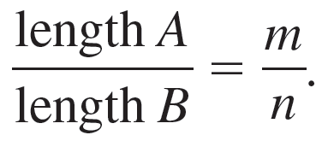
The Irrationality of
When mathematics flourished at the time of the ancient Greeks, mathematicians believed that given any two line segments, say A:
, a certain unit of length could be found so that segment A was exactly m units long and segment B was exactly n units long, for some integers m and n. (The segments were said to be commensurable with respect to this special unit of length.) Then the ratio of the lengths of A and B would be in the same proportion as the ratio of the integers m and n. Symbolically:
and B:

Slide 4

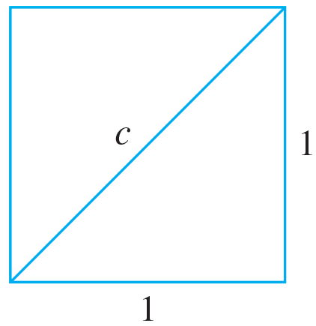


The Irrationality of
Now it is easy to find a line segment of length
just take the diagonal of a unit square:
By the Pythagorean theorem,
and so

Slide 5
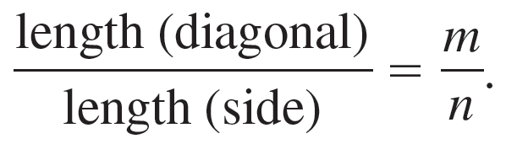
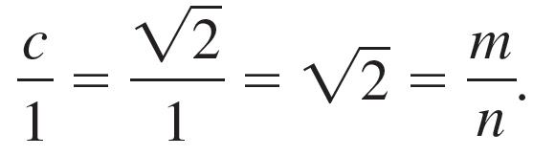

The Irrationality of
If the belief of the ancient Greeks were correct, there would be integers m and n such that
And this would imply that
But then
would be a ratio of two integers, or, in other words,
would be rational.

Slide 6
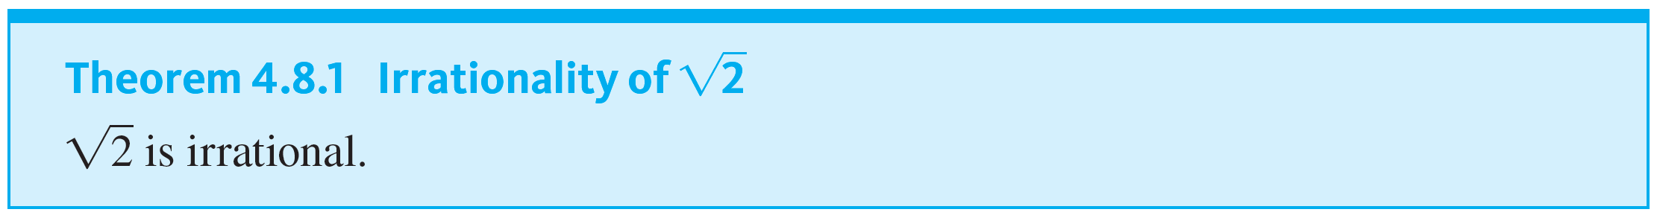
The Irrationality of

Slide 7


Example 4.8.1 – Irrationality of
Prove by contradiction that
is irrational.

Slide 8

Example 4.8.1 – Solution
The essence of the argument is the observation that if
could be written as a ratio of integers, then so could
But by Theorem 4.8.1, we know that to be impossible.

Slide 9
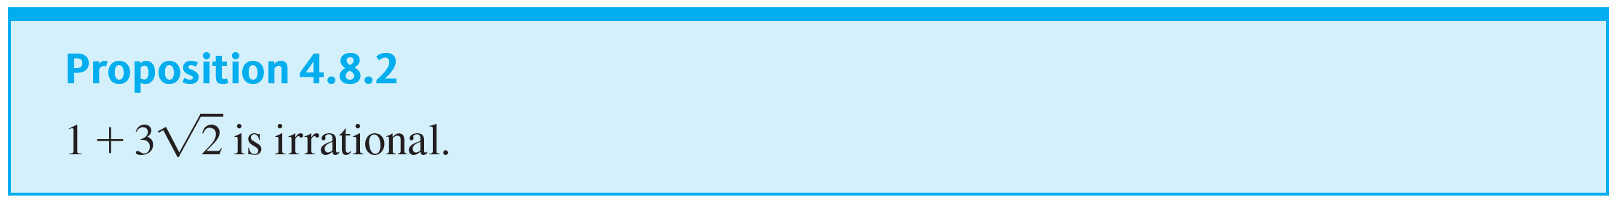
The Irrationality of

Slide 10
Are There Infinitely Many Prime Numbers?

Slide 11
Are There Infinitely Many Prime Numbers?
You know that a prime number is a positive integer that cannot be factored as a product of two smaller positive integers. Is the set of all such numbers infinite, or is there a largest prime number? The answer was known to Euclid, and a proof that the set of all prime numbers is infinite.
Euclid’s proof requires one additional fact we have not yet established: If a prime number divides an integer, then it does not divide the next successive integer.

Slide 12

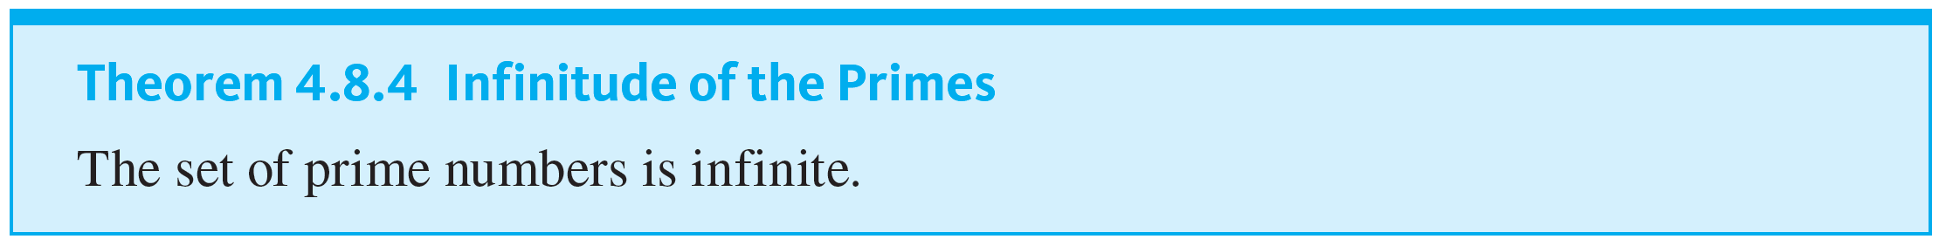
Are There Infinitely Many Prime Numbers?

Slide 13
When to Use Indirect Proof

Slide 14
When to Use Indirect Proof
The example in this section have not provided a definitive answer to the question of when to prove a statement directly and when to prove it indirectly. Many theorems can be proved either way. Usually, however, when both types of proof are possible, indirect proof is clumsier than direct proof.
In the absence of obvious clues suggesting indirect argument, try first to prove a statement directly. Then, if that does not succeed, look for a counterexample. If the search for a counterexample is unsuccessful, look for a proof by contradiction or contraposition.

